Slide 1
Debugging. Handling exceptions
Ivaniuk Oleh
11.2019

Slide 2
Agenda
Debugging
JavaScript debugging methods
Errors types
Errors & Exceptions Handling
Error object
try..catch
throw
try..catch..finaly

Slide 3
Debugging

Slide 4
Main concept
It is common to have errors while writing codes and the errors can be due to syntax or logical.
Many of these errors are difficult to detect.
Further complicating the situation is that when the program code contains errors, nothing happens.
A mistake in a program or a script is referred to as a bug.
The process of finding and fixing bugs is called debugging and is a normal part of the development process.

Slide 5
JavaScript debugging methods
There are various ways to debug your JavaScript code:
1) use a JavaScript validator
2) console.log() method
3) use a debugger keyword
4) setting breakpoints

Slide 6
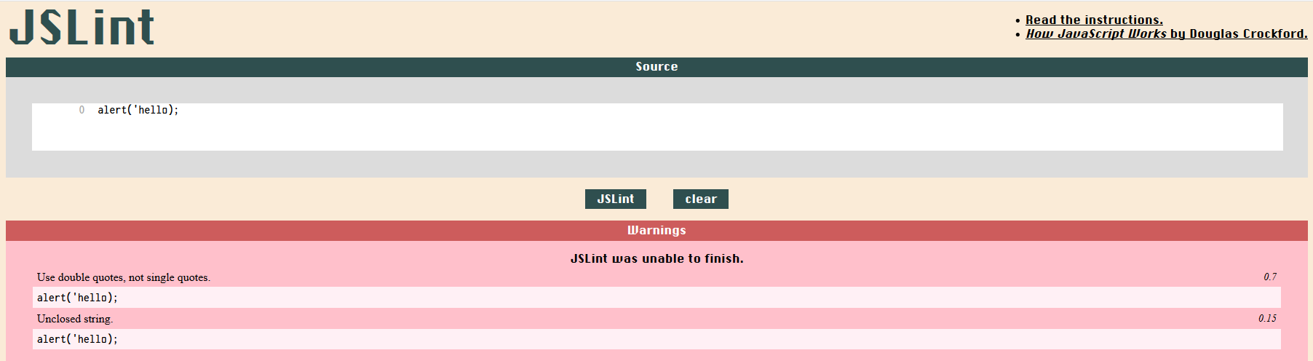
Debugging methods. 1) JavaScript Validator
One way to check your JavaScript code for strange bugs is to run it through a program that checks it to make sure it is valid and that it follows the official syntax rules of the language. These programs are called validating parsers or just validators for short, and often come with commercial HTML and JavaScript editors.
The most convenient validator for JavaScript is Douglas Crockford's JavaScript Lint, which is available for free at Douglas Crockford's JavaScript Lint.

Slide 7
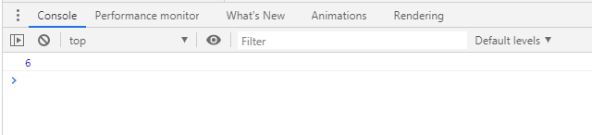
Debugging methods. 2) Console.log() method
If your browser supports debugging, you can use console.log() to display JavaScript values in the debugger window:
<script> x = 10; y = 4; z = x - y; console.log(z); </script>
In most browsers, you need to press F12 (access the developer tools) to access the console and select the tab you want.

Slide 8
Debugging methods. 3) Debugger keyword
The debugger keyword is used in the code to force stop the execution of the code at a breaking point and calls the debugging function (if available).
<body>
<h2>Debugging with Debugger keyword</h2>
<p>Result of expression calculation:</p>
<p id="calcResult"></p>
<p>If the debugger is turned on the code stops
execution at the start of the debugger</p>
<script>
var a = 10;
var b = 25;
var result = a - Math.sqrt(b);
debugger;
document.getElementById("calcResult").innerHTML = result;
</script>
</body>

Slide 9
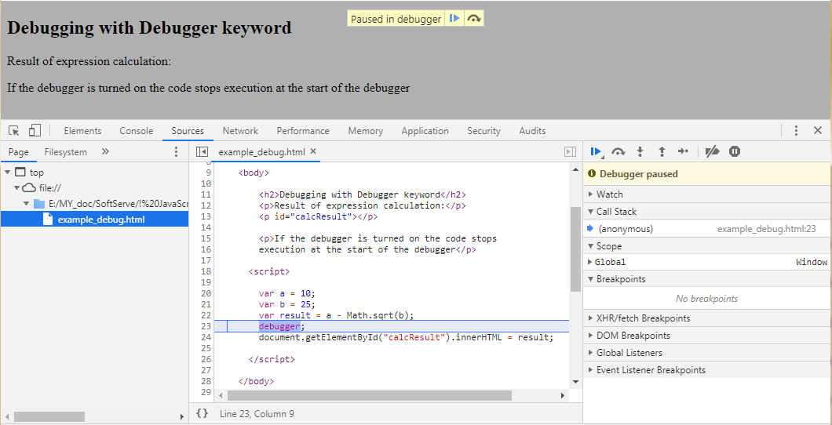
Debugging methods. 3) Debugger keyword
Going to Developer Tools and clicking on the Sourses tab we get into Debugger tool.
The code stops at the debugger point and we can analyze the code.
We can continue executing the code by pressing the play button.
Sourses files
Sourse file code
Debugger

Slide 10
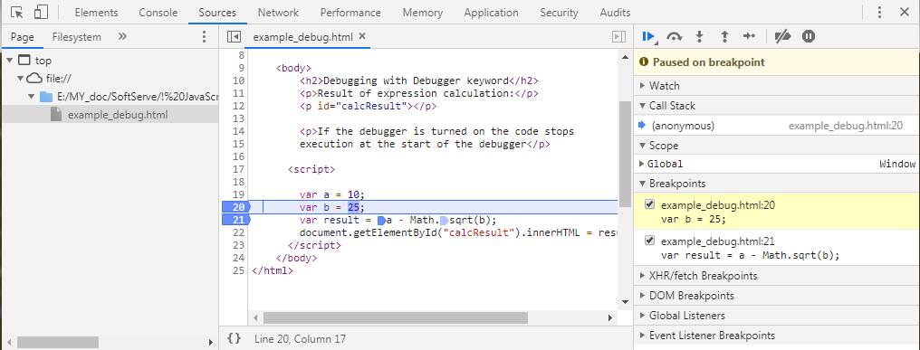
Debugging methods. 4) Setting breakpoints
In the debugger window, you can set breakpoints in the JavaScript code.
At each breakpoint, JavaScript will stop executing, and let you examine JavaScript values.
After examining values, you can resume the execution of code (typically with a play button).
Breakpoints

Slide 11
Errors types

Slide 12
Types of errors
No matter how good we are at programming, sometimes our scripts contain errors. They can occur due to our misses, unexpected user input, incorrect server response, and for many other reasons.
There are three types of errors in programming:
Syntax Errors
Runtime Errors
Logical Errors

Slide 13
Syntax errors
Syntax errors, also called parsing errors, occur at compile time in traditional programming languages and at interpret time in JavaScript.
For example, the following line causes a syntax error because it is missing a closing parenthesis.
<script type = "text/javascript">
<!--
window.print(;
//-->
</script>
When a syntax error occurs in JavaScript, only the code contained within the same thread as the syntax error is affected and the rest of the code in other threads gets executed assuming nothing in them depends on the code containing the error.
Notes:
Коли в JavaScript виникає синтаксична помилка, це стосується тільки коду, що міститься в тому ж потоці, що і синтаксична помилка, а інша частина коду в інших потоках виконується, якщо в них нічого не залежить від коду, що містить помилку.

Slide 14
Runtime errors
Runtime errors, also called exceptions, occur during execution (after compilation/interpretation).
For example, the following line causes a runtime error because here the syntax is correct, but at runtime, it is trying to call a method that does not exist.
<script type = "text/javascript">
<!--
printMe();
//-->
</script>
Exceptions also affect the thread in which they occur, allowing other JavaScript threads to continue normal execution.

Slide 15
Logical errors
Logic errors can be the most difficult type of errors to track down. These errors are not the result of a syntax or runtime error. Instead, they occur when you make a mistake in the logic that drives your script and you do not get the result you expected.
You cannot catch those errors, because it depends on your business requirement what type of logic you want to put in your program.

Slide 16
Errors & Exceptions Handling

Slide 17
JavaScript exceptions
Usually, a script “dies” (immediately stops) in case of an error, printing it to console.
Sometimes during program execution errors occur that are difficult to foresee or anticipate, and sometimes not at all possible, such situations are called exceptions.
In case of an exception, the script execution stops and information about the exception is displayed in the console
But JavaScript has a try..catch syntax that allows you to "catch" exceptions and do something more meaningful instead of crashing.

Slide 18
Construction try..catch
Syntax of using the try..catch construct:
try {
// Code to run
} catch (exception) {
// Code to run if an exception occurs
}
First, the code in try {...} is executed.
If there were no errors, then catch(exception) is ignored: the execution reaches the end of try and goes on, skipping catch.
If an error occurs, then try execution is stopped, and the control flows to the beginning of catch(exception). The exception variable (can use any name for it) will contain an error object with details about what happened.
Notes:
Блок catch містить команди, які визначають, що робити, якщо викинуто виняток у блоці try. Отже, ви хочете, щоб блок try виконався успішно, а в разі неуспіху ви хочете передати контроль до блоку catch. В разі, якщо будь-який вираз всередині блоку try (або функція, викликана зсередини блоку try) викидає виняток, контроль негайно переходить до блоку catch. Якщо жодних винятків у блоці try не було викинуто, блок catch пропускається.

Slide 19
Handling exceptions
Case 1:
try {
console.log('Try block start');
// ... Code without errors
console.log('Try block end');
} catch(error) {
console.log('Catch is ignored,
because there are no errors');
}
console.log('Code after try..catch');
Case 2:
try {
console.log('Try block start');
c = a + b; // some logic in code
console.log('Try block end');
} catch(error) {
console.log('Error has occurred!');
}
console.log('Code after try..catch');
Console output:
Try block start
Try block end
Code after try..catch
Console output:
Try block start
Error has occurred!
Code after try..catch

Slide 20
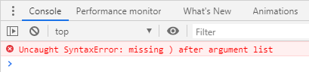
Handling exceptions. Syntax errors
!
try..catch only works for runtime errors
In order for the try..catch design to work, the JavaScript code must be valid.
try..catch will not work if the code has syntax errors, for example, contains a mismatching number of braces:
try {
console.log('Some text here'
} catch(exception) {
console.log('try..catch does not work,
the code is incorrect');
}
Notes:
Для того, щоб конструкція try..catch могла відпрацювати потрібно, щоб JavaScript-код був коректним
try..catch не буде працювати, якщо в коді є синтаксичні помилки, наприклад, містить некоректну кількість фігурних дужок:

Slide 21
Handling exceptions. Error object
JavaScript has a built in error object that provides error information when an error occurs.
The error object provides two useful properties: name and message.
name – type of error. For example, when accessing a nonexistent variable: ReferenceError.
message – text message about error details
stack – contains a string with information about the sequence of calls that led to the error, in older browsers
Error object properties:
try {
new User();
} catch (exception) {
console.log(exception.name); // "ReferenceError"
console.log(exception.message); // "User is not defined"
console.log(exception.stack); // "ReferenceError:User is not defined at example.html:42 "
}

Slide 22
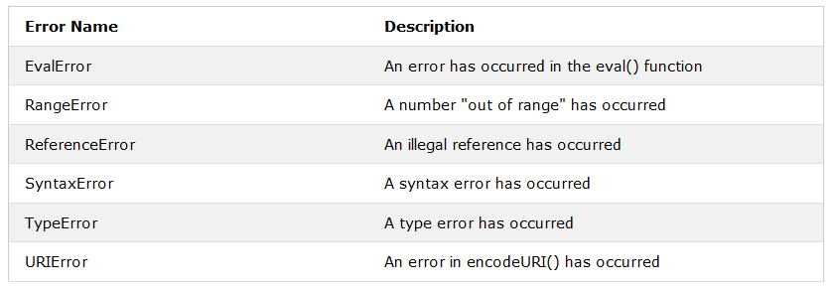
Handling exceptions. Error name types
Six different types (values) can be returned by the error name property:
Error name types (values)
In fact, these are built-in constructors for standard errors.
Notes:
Метод eval() виконує JavaScript код, представлений стрінгою.
RangeError викидається, якщо ви використовуєте число, яке знаходиться поза діапазоном коректних значень.
ReferenceError викидається, якщо ви використовуєте (посилання) змінну, яку не було оголошено:
TypeError викидається, якщо ви використовуєте значення, яке знаходиться поза діапазоном очікуваних типів:
URIError(Uniform Resource Identifier) викидається, якщо ви використовуєте некоректні символи у функції URI: URL - це URI, який, мабуть, точно ідентифікує ресурс, передає свою інформацію та інформацію про місцеположення цього ресурсу.

Slide 23
Handling exceptions. Own exceptions generation
It is possible to generate (create) your own exceptions, the throw keyword is used for this, followed by the error object:
throw <error object>
You can pass anything as an error object, for example, a number or a string, but it is desirable that it be an object compatible with the standard one, at least with the presence of the name and message properties.
It is possible to use built-in constructors for standard errors: Error, SyntaxError, ReferenceError, TypeError.
Example:
let error = new SyntaxError(message);
let error = new ReferenceError(message);

Slide 24
Handling exceptions. Own exceptions generation
The enterPIN() function asks the user to enter a PIN number, if the number is more than 4 characters, it throws an exception. Depending on what the user enters, the script will behave differently.
function enterPIN() {
let pin = prompt("Enter PIN-number (max length 4):", "");
if (pin.length > 4) {
throw new Error("Line length greater than 4 characters");
}
return pin;
}
try {
let result = enterPIN();
console.log(result);
} catch (exception) {
console.log(exception.name);
console.log(exception.message);
console.log(exception.stack);
}

Slide 25
Handling exceptions. Rethrowing
Considering that there are different types of errors, only some of them can be processed in the catch block, and the rest can be forwarded further.
In other words, if catch cannot handle the exception, it throws it again:
function func() {
try {
someVar;
} catch (error) {
if (error.name === "TypeError") {
console.log("Error handling TypeError type");
console.log(error.message);
} else {
throw error;
}
}
}

Slide 26
Handling exceptions. Rethrowing
try {
func();
} catch (error) {
console.log("Error handling of any type");
console.log(error.message);
}
Inside the func() function, only TypeError exceptions are processed, all other exceptions are thrown further into its called code
Please note, if you remove try...catch around the func() function call, the script will be stopped if the exception is different from TypeError.

Slide 27
Handling exceptions. Construction try..catch..finaly
The try ... catch construct may contain another block: finally
The finally section is optional, but if there is one, it is always executed:
1) after try block, if there were no errors
2) after catch if there were errors
try {
console.log("Section try");
count = count + 1;
} catch (error) {
console.log("Section catch");
console.log(error.message);
} finally {
console.log("Section finally");
}

Slide 28
Handling exceptions. Construction try..catch..finaly
As a result, the browser console will display the following output:
if the variable count is defined:
Section try
Section finally
if count is not defined :
Section try
Section catch
count is not defined
Section finally
The finally section is used to complete the started operations for any scenario. For example, a logging system, whether or not an exception occurred, there will always be a record that the function was running.

Slide 29
Handling exceptions. Finaly & return
The finally block is triggered on any exit from try ... catch, including return:
function func() {
try {
return 1;
} catch (error) {
console.log("Section catch");
} finally {
console.log("Section finally");
}
}
let result = func(); // "Section finally"
console.log(result); // 1
If inside try any processes that need to be completed at the end of work have been started, in finally it will definitely be done
!
Can use finally without catch
Notes:
Блок finally спрацьовує при будь-якому виході з try ... catch, в тому числі і return
Якщо всередині try були розпочаті якісь процеси, які потрібно завершити після закінчення роботи, у finally це обов'язково буде зроблено

Slide 30
Useful links
https://dou.ua/lenta/articles/chrome-dev-tools-guide/
https://flaviocopes.com/javascript-debugging/
http://learn.javascript.ru/debugging-chrome
https://www.w3schools.com/js/js_errors.asp
http://learn.javascript.ru/try-catch

Slide 31
THANKS

